Slide 1
Implementing HTTP Services In Node.js
B.Harshini
22H51A05M1
CSE-D

Slide 2
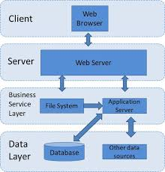
Introduction to HTTP Services in Node.js
Node.js is an event-driven JavaScript runtime built on Chrome's V8 engine.
It enables developers to build scalable network applications easily and efficiently.
Implementing HTTP services in Node.js allows for creating robust web applications and APIs.

Slide 3
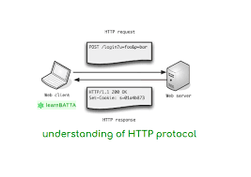
Understanding HTTP Protocol
HTTP (Hypertext Transfer Protocol) is the foundation of data communication on the web.
It defines how messages are formatted and transmitted between clients and servers.
Understanding HTTP methods like GET, POST, PUT, and DELETE is crucial for service implementation.

Slide 4
Setting Up a Node.js Environment
To start building HTTP services, ensure Node.js and npm are installed on your system.
Create a new directory for your project and initialize it using npm to manage dependencies.
Install the 'express' framework, which simplifies the process of creating HTTP servers in Node.js.

Slide 5
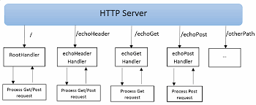
Creating a Basic HTTP Server
Use the 'http' module to create a simple HTTP server in Node.js.
Listen for incoming requests and send responses using the response object.
This foundational server can be expanded to handle various routes and serve different content.

Slide 6
Using Express for HTTP Services
Express is a robust web application framework that simplifies HTTP server creation.
It provides middleware for handling requests, responses, and routing easily.
Leveraging Express can significantly reduce the amount of code needed for complex applications.

Slide 7
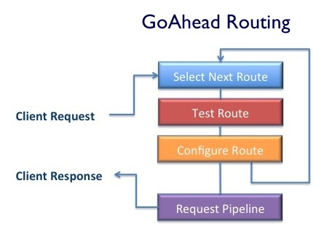
Routing HTTP Requests
Routing is essential for defining how your application responds to different URL paths.
Use Express's routing methods like app.get(), app.post(), etc., to handle specific HTTP methods.
Organizing routes in a modular way improves maintainability and clarity in your code.

Slide 8
Error Handling in HTTP Services
Proper error handling is crucial for maintaining a smooth user experience in your application.
Utilize Express's built-in error handling middleware to catch and respond to errors gracefully.
Providing meaningful error messages can help users understand issues and guide developers in debugging.

Slide 9
Conclusion
Implementing HTTP services in Node.js is an efficient way to build modern web applications.
Always adhere to best practices, such as keeping your code modular and maintaining performance.
Continuous learning and staying updated with the latest Node.js features will enhance your development skills.

Slide 10
THANK YOU

